Slide 1

Database Management System
Query Processing

Slide 2
Chapter 13: Query Processing
Overview
Measures of Query Cost
Selection Operation
Join Operation
Project Operation
Evaluation of Expressions

Slide 3

Basic Steps in Query Processing
1. Parsing and translation
2. Optimization
3. Evaluation

Slide 4
Basic Steps in Query Processing (Cont.)
Parsing and translation
  Translate the query into its internal form. This is then translated into relational algebra.
  Parser checks syntax, verifies relations
Evaluation
  The query-execution engine takes a query-evaluation plan, executes that plan, and returns the answers to the query.

Slide 5
Basic Steps in Query Processing : Optimization
A relational algebra expression may have many equivalent expressions
  E.g., σ_{salary<75000}(∏_{salary}(instructor)) is equivalent to
  ∏_{salary}(σ_{salary<75000}(instructor))
Each relational algebra operation can be evaluated using one of several different algorithms
  Correspondingly, a relational-algebra expression can be evaluated in many ways.
Annotated expression specifying detailed evaluation strategy is called an evaluation-plan.
  E.g., can use an index on salary to find instructors with salary < 75000,
  or can perform complete relation scan and discard instructors with salary ≥ 75000

Slide 6
Measures of Query Cost
Cost is generally measured as total elapsed time for answering query
  Many factors contribute to time cost
    disk accesses, CPU, or even network communication
Typically disk access is the predominant cost, and is also relatively easy to estimate. Measured by taking into account
  Number of seeks * average-seek-cost
  Number of blocks read * average-block-read-cost
  Number of blocks written * average-block-write-cost

Slide 7
Measures of Query Cost (Cont.)
For simplicity we just use number of block transfers from disk as the cost measure
  We ignore the difference in cost between sequential and random I/O for simplicity
  We also ignore CPU costs for simplicity
  t_{T} – time to transfer one block
  t_{S} – time for one seek
  Cost for b block transfers plus S seeks
  b * t_{T} + S * t_{S}
Costs depends on the size of the buffer in main memory
  Having more memory reduces need for disk access
  Amount of real memory available to buffer depends on other concurrent OS processes, and hard to determine ahead of actual execution
  We often use worst case estimates, assuming only the minimum amount of memory needed for the operation is available

Slide 8
Selection Operation
File scan – search algorithms that locate and retrieve records that fulfill a selection condition.
Algorithm A1 (linear search). Scan each file block and test all records to see whether they satisfy the selection condition.
  Cost estimate (number of disk blocks scanned) = b_{r}
    b_{r} denotes number of blocks containing records from relation r
  Linear search can be applied regardless of
    selection condition or
    ordering of records in the file, or
    availability of indices

Slide 9
Selections Using Indices
Index scan – search algorithms that use an index
  selection condition must be on search-key of index.
A3 (primary index on candidate key, equality). Retrieve a single record that satisfies the corresponding equality condition
  Cost = HT_{i} + t_{T} + t_{S}
A4 (primary index on nonkey, equality) Retrieve multiple records.
  Records will be on consecutive blocks
  Cost = HT_{i} + number of blocks containing retrieved records * (t_{T} + t_{S} )
A5 (equality on search-key of secondary index).
  Retrieve a single record if the search-key is a candidate key
    Cost = HT_{i} + t_{T} + t_{S}
  Retrieve multiple records if search-key is not a candidate key
    Cost = HT_{i} + number of records retrieved
    each record may be on a different block
      one block access for each retrieved record

Slide 10
Selections Involving Comparisons
Can implement selections of the form σ_{A≤V} (r) or σ_{A ≥ V}(r) by using
  a linear file scan or binary search,
  or by using indices in the following ways:
A6 (primary index, comparison). (Relation is sorted on A)
    For σ_{A ≥ V}(r) use index to find first tuple ≥ v and scan relation sequentially from there
    For σ_{A≤V} (r) just scan relation sequentially till first tuple > v; do not use index
A7 (secondary index, comparison).
    For σ_{A ≥ V}(r) use index to find first index entry ≥ v and scan index sequentially from there, to find pointers to records.
    For σ_{A≤V} (r) just scan leaf pages of index finding pointers to records, till first entry > v

Slide 11
Implementation of Complex Selections
Conjunction: σ_{θ1}∧ _{θ2}∧. . . _{θn}(r)
A8 (conjunctive selection using one index).
  Select a combination of θ_{i} and algorithms A1 through A7 that results in the least cost for σ_{θi} (r).
Disjunction:σ_{θ1}∨ _{θ2} ∨. . . _{θn} (r).
A11 (disjunctive selection by union of identifiers).
  Applicable if all conditions have available indices.
  Use corresponding index for each condition, and take union of all the obtained sets of record pointers.
  Then fetch records from file
Negation: σ_{¬θ}(r)
  Use linear scan on file
  If very few records satisfy ¬θ, and an index is applicable to θ
    Find satisfying records using index and fetch from file

Slide 12
Join Operation
Several different algorithms to implement joins
  Nested-loop join
  Block nested-loop join
  Indexed nested-loop join
  Merge-join
Choice based on cost estimate
Examples use the following information
  Number of records of student: 5,000 takes: 10,000
  Number of blocks of student: 100 takes: 400

Slide 13
Nested-Loop Join
To compute the theta join r _{θ} s
for each tuple t_{r} in r do begin
for each tuple t_{s} in s do begin
test pair (t_{r},t_{s}) to see if they satisfy the join condition θ
if they do, add t_{r} • t_{s} to the result.
end
end
r is called the outer relation and s the inner relation of the join.
Requires no indices and can be used with any kind of join condition.
Expensive since it examines every pair of tuples in the two relations.

Slide 14
Nested-Loop Join (Cont.)
In the worst case, if there is enough memory only to hold one block of each relation, the estimated cost is
n_{r} ∗ b_{s} + b_{r} block transfers, plus
n_{r} + b_{r} seeks
If the smaller relation fits entirely in memory, use that as the inner relation.
  Reduces cost to b_{r} + b_{s} block transfers and 2 seeks
Assuming worst case memory availability cost estimate is
  with student as outer relation:
    5000 ∗ 400 + 100 = 2,000,100 block transfers,
    5000 + 100 = 5100 seeks
  with takes as the outer relation
    10000 ∗ 100 + 400 = 1,000,400 block transfers and 10,400 seeks
If smaller relation (student) fits entirely in memory, the cost estimate will be 500 block transfers.

Slide 15
Block Nested-Loop Join
Variant of nested-loop join in which every block of inner relation is paired with every block of outer relation.
for each block B_{r} of r do begin
for each block B_{s} of s do begin
for each tuple t_{r} in B_{r} do begin
for each tuple t_{s} in B_{s} do begin
Check if (t_{r},t_{s}) satisfy the join condition
if they do, add t_{r} • t_{s} to the result.
end
end
end
end

Slide 16
Block Nested-Loop Join (Cont.)
Worst case estimate: b_{r} ∗ b_{s} + b_{r} block accesses.
  Each block in the inner relation s is read once for each block in the outer relation (instead of once for each tuple in the outer relation
Best case: b_{r} + b_{s} block accesses.

Slide 17
Indexed Nested-Loop Join
Index lookups can replace file scans if
  join is an equi-join or natural join and
  an index is available on the inner relation’s join attribute
    Can construct an index just to compute a join.
For each tuple t_{r} in the outer relation r, use the index to look up tuples in s that satisfy the join condition with tuple t_{r}.
Worst case: buffer has space for only one page of r, and, for each tuple in r, we perform an index lookup on s.
Cost of the join: b_{r} + n_{r} ∗ c
  Where c is the cost of traversing index and fetching all matching s tuples for one tuple or r
  c can be estimated as cost of a single selection on s using the join condition.
If indices are available on join attributes of both r and s,
use the relation with fewer tuples as the outer relation.

Slide 18
Example of Nested-Loop Join Costs
Compute student takes, with student as the outer relation.
Let takes have a primary B⁺-tree index on the attribute ID, which contains 20 entries in each index node.
Since takes has 10,000 tuples, the height of the tree is 4, and one more access is needed to find the actual data
student has 5000 tuples
Cost of block nested loops join
  400*100 + 100 = 40,100 block transfers + 2 * 100 = 200 seeks
    assuming worst case memory
    may be significantly less with more memory
Cost of indexed nested loops join
  100 + 5000 * 5 = 25,100 block transfers and seeks.

Slide 19
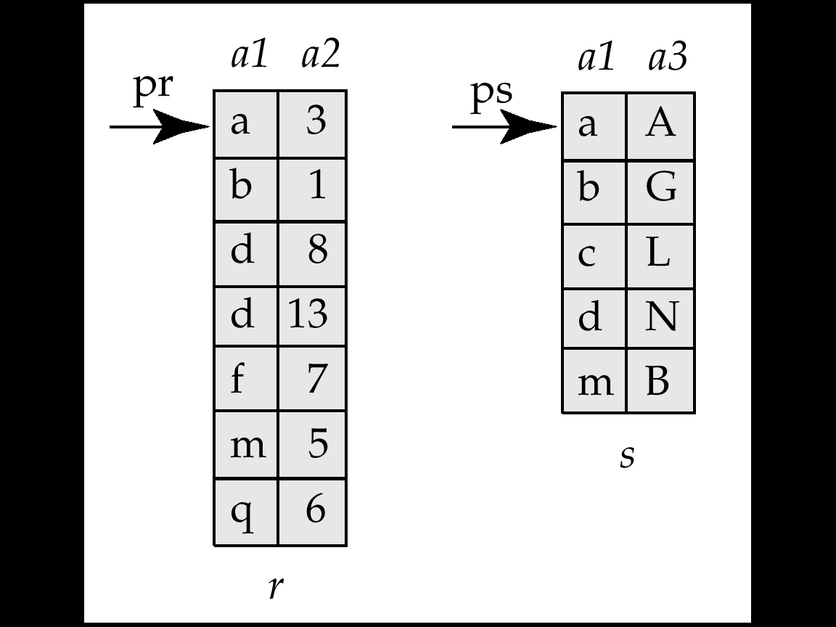
Merge-Join
Sort both relations on their join attribute (if not already sorted on the join attributes).
Merge the sorted relations to join them
  Join step is similar to the merge stage of the sort-merge algorithm.
  Main difference is handling of duplicate values in join attribute — every pair with same value on join attribute must be matched

Slide 20
Merge-Join (Cont.)
Can be used only for equi-joins and natural joins
Each block needs to be read only once (assuming all tuples for any given value of the join attributes fit in memory
Thus number of block accesses for merge-join is
b_{r} + b_{s} + the cost of sorting if relations are unsorted.

Slide 21
Other Operations
Duplicate elimination can be implemented via sorting.
  On sorting duplicates will come adjacent to each other, and all but one set of duplicates can be deleted..
Projection is implemented by performing projection on each tuple followed by duplicate elimination.

Slide 22

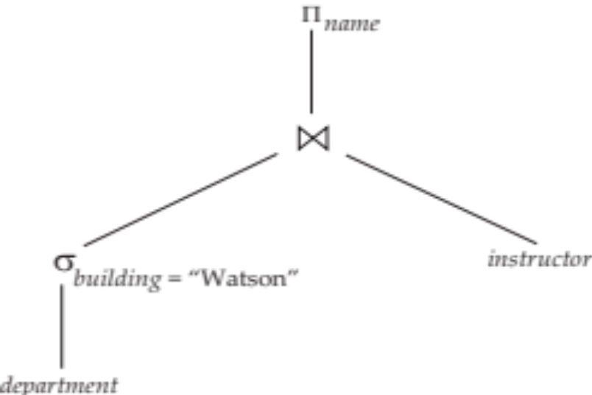
Evaluation of Expressions
Materialized evaluation: evaluate one operation at a time, starting at the lowest-level. Use intermediate results materialized into temporary relations to evaluate next-level operations.
E.g., in figure below, compute and store
then compute the store its join with instructor, and finally compute the projection on name.

Slide 23
Materialization (Cont.)
Materialized evaluation is always applicable
Cost of writing results to disk and reading them back can be quite high
  Our cost formulas for operations ignore cost of writing results to disk, so
    Overall cost = Sum of costs of individual operations +
    cost of writing intermediate results to disk

